Slide 1
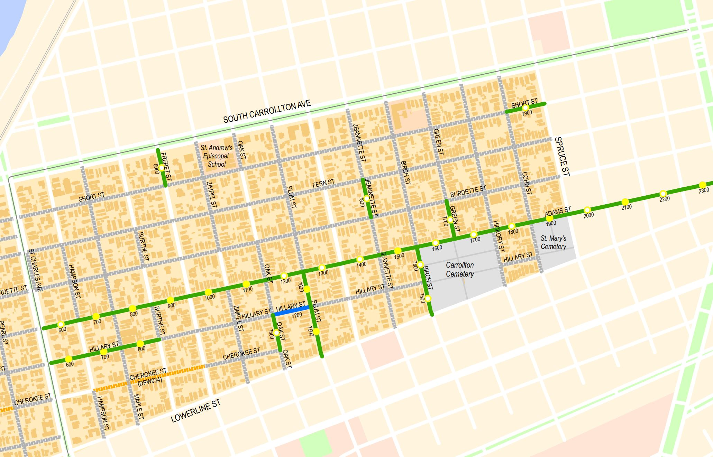

East Carrollton Group B & C Pre-Construction Community Meeting
December 27, 2023

Slide 2

Meeting Agenda
Meet the Team
Lauren Muse, Community Outreach Manager, RoadworkNOLA
Program Overview
Ryan Donegan, Project Manager, Department of Public Works
Project Information
Ryan Donegan, Project Manager, Department of Public Works
Joel Galatas, Project Manager, Sewer &Water Board
Historic Preservation
Philip Gilmore, DPW Historic Preservation
Stay Informed
Lauren Muse, Community Outreach Specialist, RoadworkNOLA
Questions & Answers
Lauren Muse, Community Outreach Manager, RoadworkNOLA

Slide 3
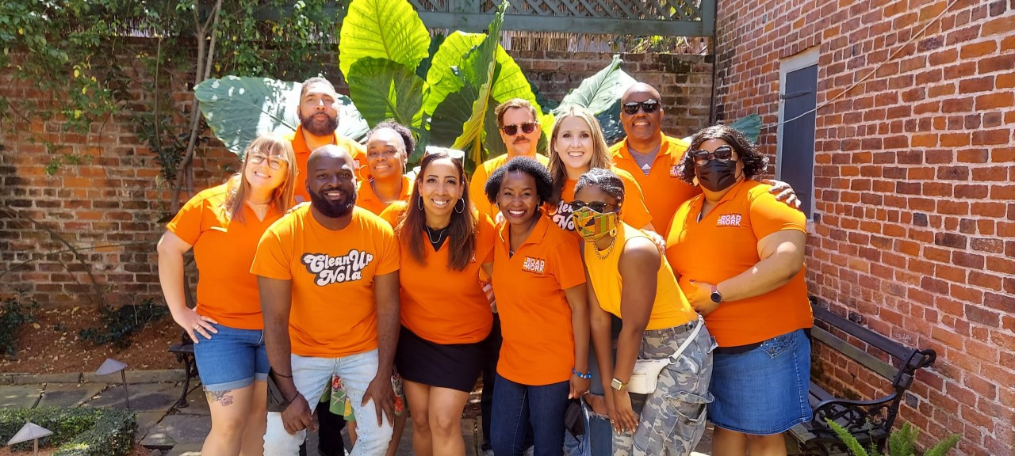
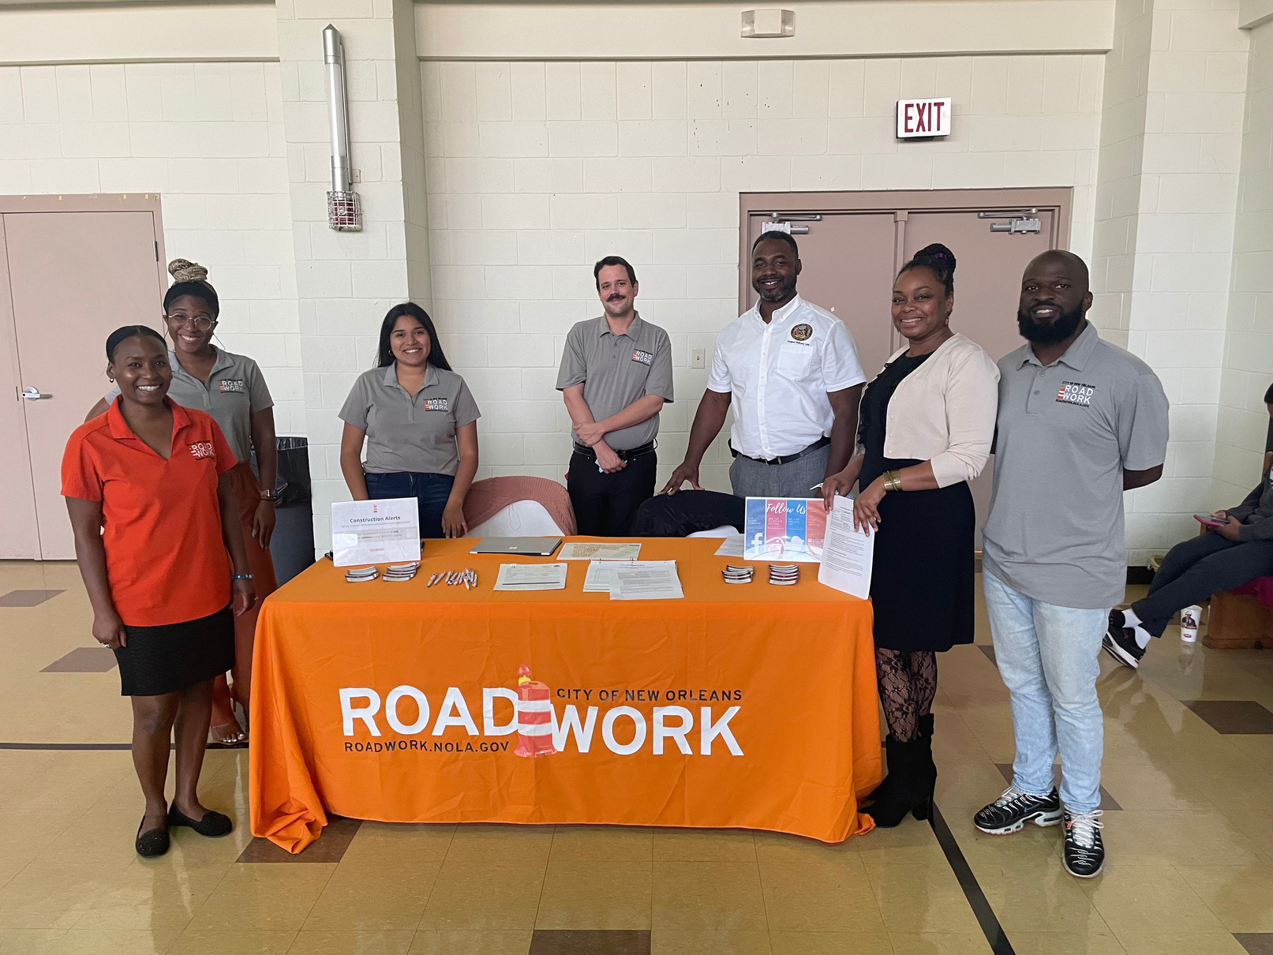
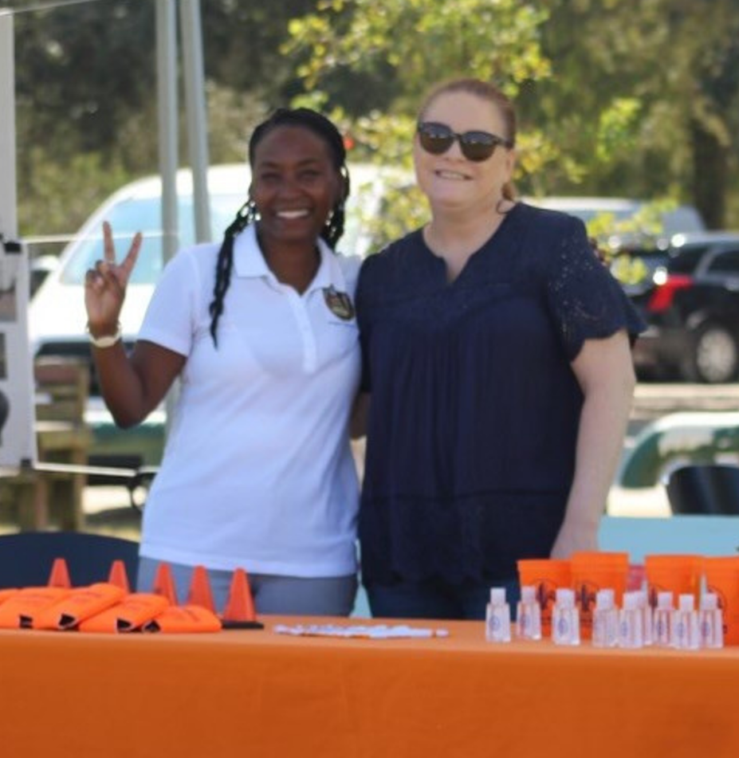
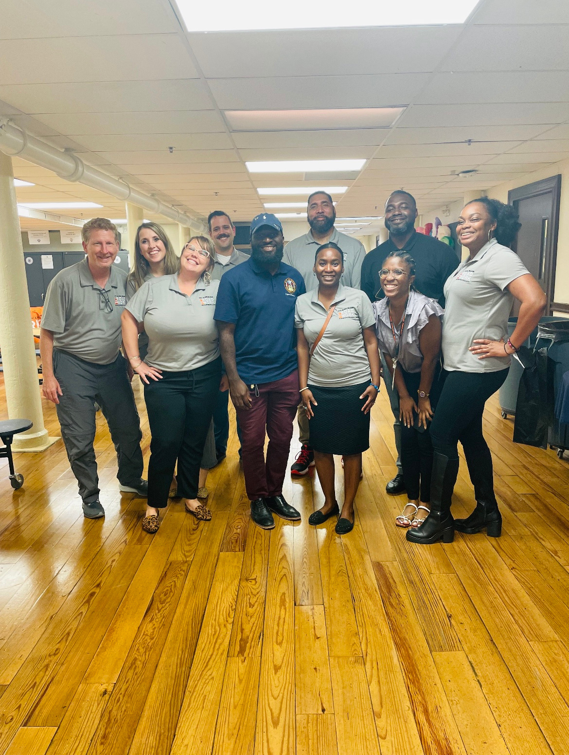
Meet the Team
RoadworkNOLA Community Outreach Liaison
Lauren Muse, Community Outreach Manager
  Lauren is here to advocate for you during construction. She works with our project team to provide you with construction updates and help resolve project-related issues.
SWBNO, Project Manager
Joel Galatas, Project Manager
DPW, Project Manager
Ryan Donegan, Project Manager
  Joel is here to work with the contractors and engineers. He will manage sewer and water utilities and ensure work is completed according to city specifications.
  Ryan is here to work with the contractors and engineers. He manages construction and ensures work is completed according to the plans and specifications of the project.

Slide 4


Infrastructure By the Numbers
$2.3B
More than $2.3B worth of DPW / SWBNO work across the City
    Includes FEMA-funded roadwork work via the approximately $2B Joint Infrastructure (JIRR) Program
    City-funded bond project work
Nearly 200 individual projects -- every neighborhood will feel this positive impact
Project schedules coordinated to minimize construction-related impacts
Economic opportunity for the City’s small and disadvantaged businesses
1
7
8
4
9
Completed
Projects
Under
Construction
Since May 2018, DPW has completed 178 projects with an estimated value of $750 million.
Since May 2018, 49 roadwork projects are under construction with an estimated value of nearly $692 million.

Slide 5
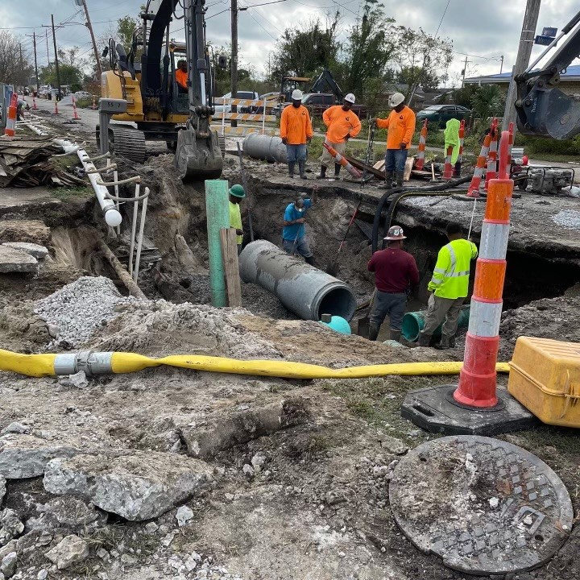




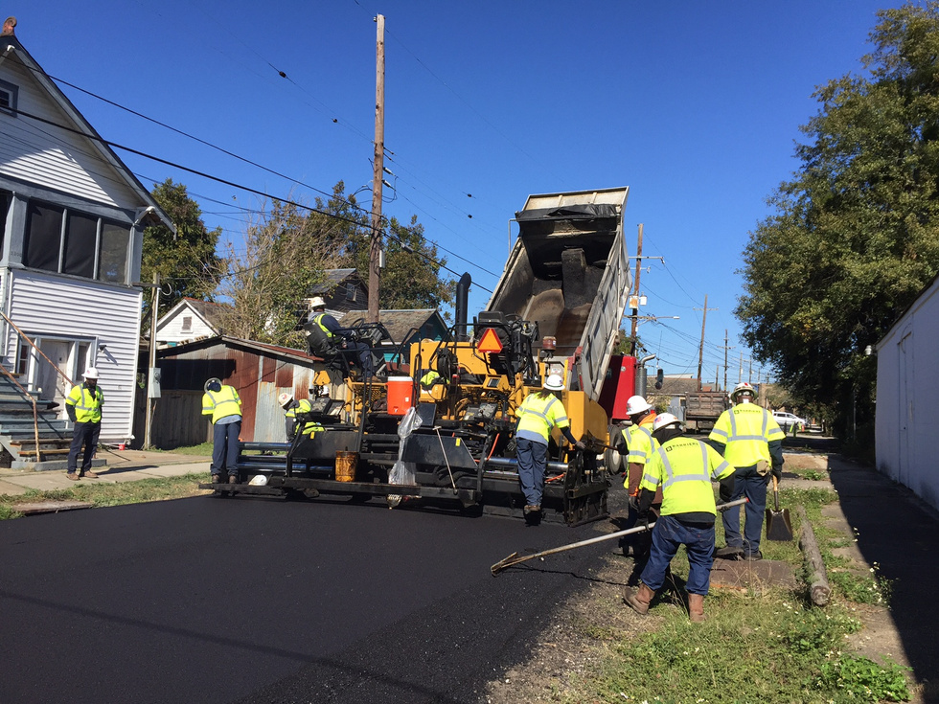
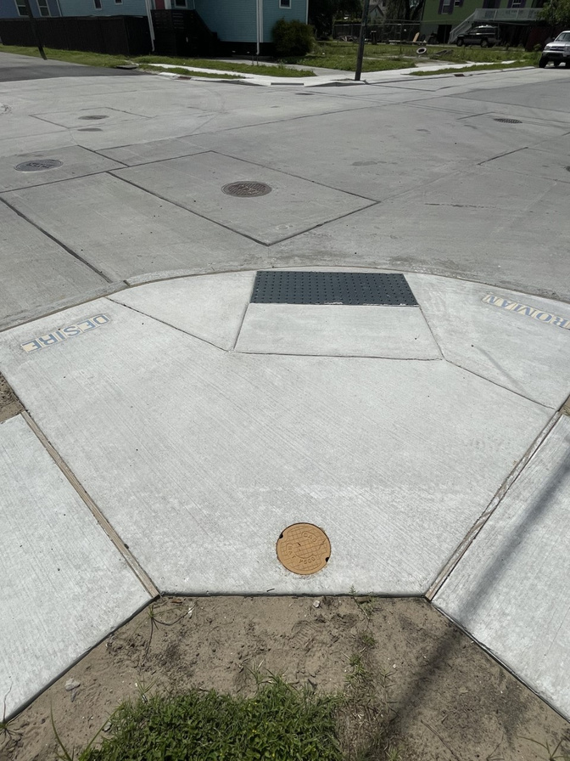


Surface Repairs
Streetscape Improvements
  Minor repairs (patching)
  Complete Resurfacing
  Sidewalk
  Sidewalk Ramps
Types of Construction
in the program
Subsurface Repairs
  Drainage Lines
  Sewer Line
  Water Lines

Slide 6

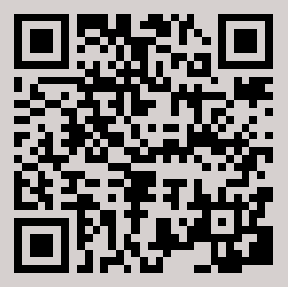

About the Project
East Carrollton Group B & C
East Carrollton Group B & C
Start Date
Jan. 2,
2024
End Date
Spring
2025
Please note that all schedules are subject to change and weather delays.
Scan here for a detailed view of the project area map.

Slide 7







East Carrollton Group B & C
Project Overview: At-A-Glance
Start Date
Jan. 2, 2024
Type of Construction
Full Reconstruction &
Patch Concrete
End Date
Spring 2025
Construction Cost
$28.7M
Surface Repairs
Subsurface Repairs
Streetscape Improvements
Funding Source
FEMA
A new, smooth roadway
New underground utilities which means better service.
ADA-compliant curb ramps at intersections
Contractor
Impetus Infrastructure, LLC
Design Engineer
Ardurra
Blocks Improved
31 blocks
Streetscape Improvements
ADA-compliant curb ramps at intersections
City Contact
Lauren Muse

Slide 8

East Carrollton Group B & C
Sewer System Evaluation and Rehabilitation Program (SSERP)
The Sewerage and Water Board of New Orleans has undertaken a multi-year program, the Sewer System Evaluation and Rehabilitation Program (SSERP), to identify and address structural and mechanical deficiencies in the wastewater collection system and to ensure that the system has adequate capacity.
The SSERP work for the East Carrollton Group B & C project has a required completion timeline of 180 days from January 2nd.
All water test closures for this project have been conducted. Therefore, expediting the water line installation processing by at least two to three weeks. All water line replacements will be connected through full line tie-ins that will be communicated to residents within 48 hours before disruptions.

Slide 9
East Carrollton Group B & C
Project Sequencing
Phase 1
Phase 2
Phase 3
Phase 4
Crews will begin working on task order 1. 600 to 800 blocks of Adams St. and Hillary St.
  Utilities (sewer*, water and drainlines),
  Roadway
  Sidewalks
  ADA ramps
Once Phase 1 is completed, crews will move into task order 2 & 7. The 800 & 1200 blocks of Adams St. and 8000 Freret St., 7800 Jeanette St., and 1900 Short St.
  Utilities (sewer*, water and drainlines),
  Roadway
  Sidewalks
  ADA ramps
After Phase 2 is completed, work will begin in task order 3 & 6. The 2100 & 2300 blocks of Adams St. and 1300 Adams, 7500 -7600 Plum, 1200 Hillary and 7500 Oak.
  Utilities (sewer*, water and drainlines),
  Roadway
  Sidewalks
  ADA ramps
Lastly, Phase 4 will be started in task orders 5 & 4. The 1700 to 2100 blocks of Adams St., 7700 Green St. and 1400 -1600 Adams St. and 7500-7600 Birch St.
  Utilities (sewer, water and drainlines),
  Roadway
  Sidewalks,
  ADA ramps
Notes:
*For sequence, we plan to have a crew begin with the consent decree sewer work across the project. We will put back temp asphalt that is in the job in order for traffic to be maintained as we complete each block.
From there, we anticipate a second crew to begin middle-end of January to begin utility work on task order 1.
To simplify, I separated the job into 2 groups that will being worked on simultaneously.
Group 1 is consent decree sewer, TO 7, 6, & 5.
Group 2 is TO 1, 2, 3, & 4

Slide 10
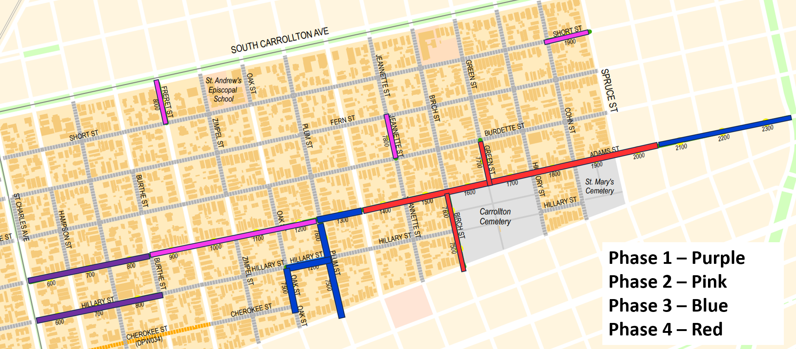
East Carrollton Group B & C

Slide 11
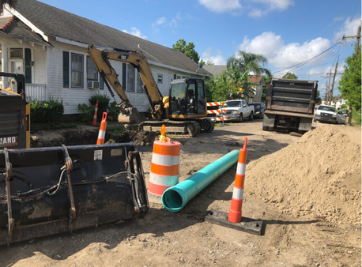
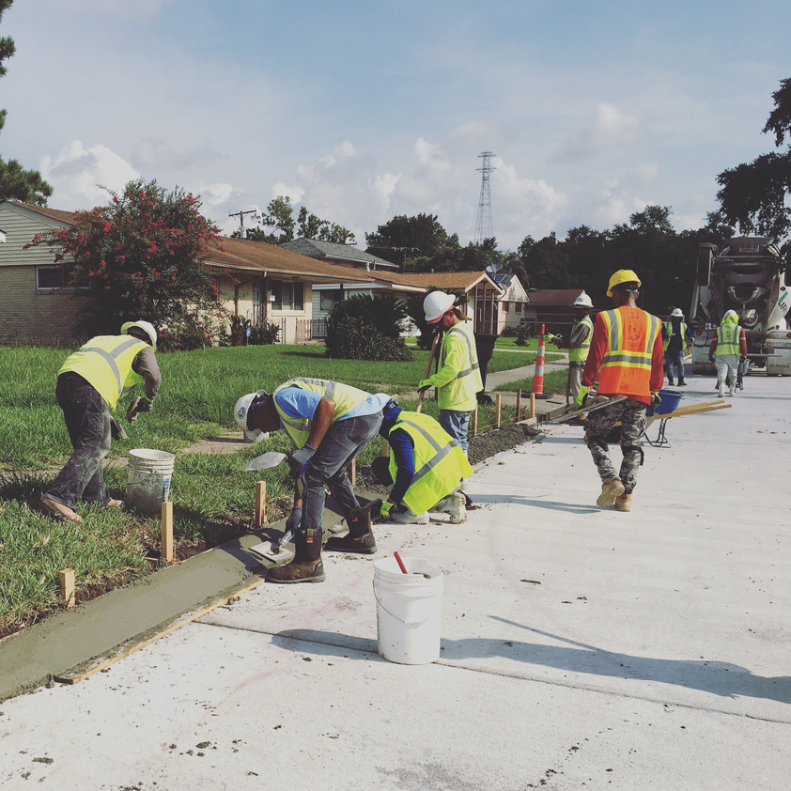
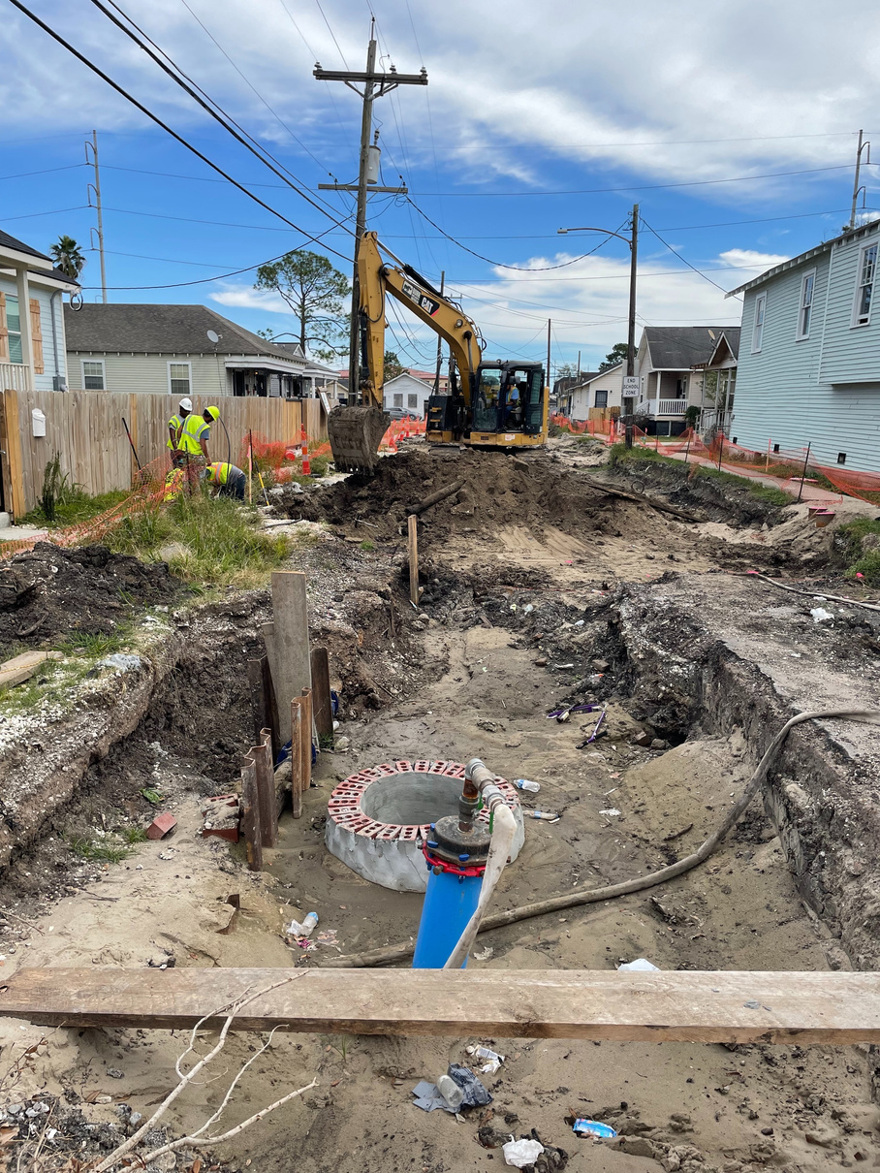
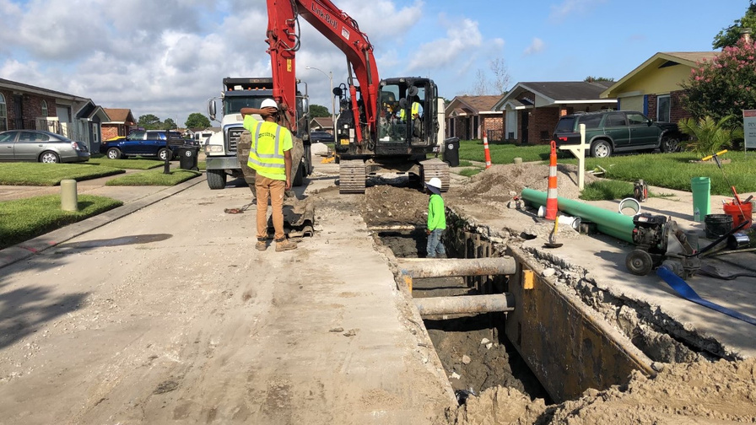
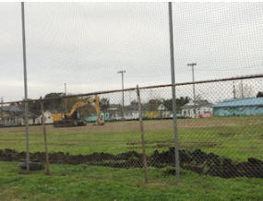
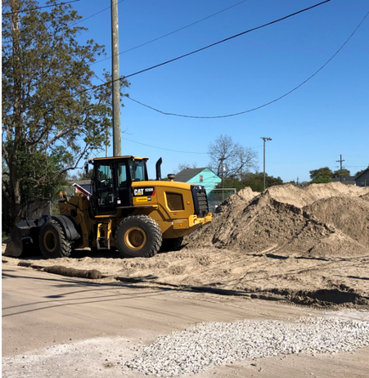

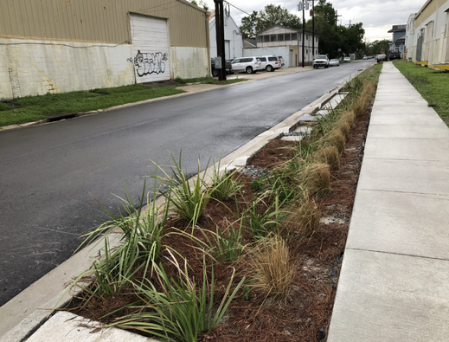
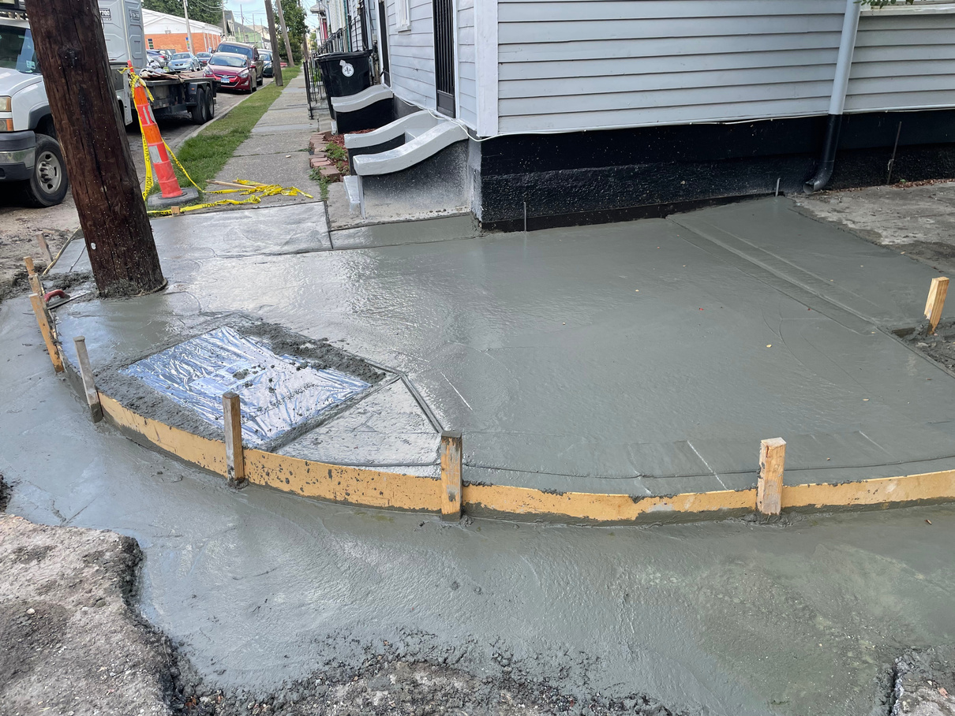
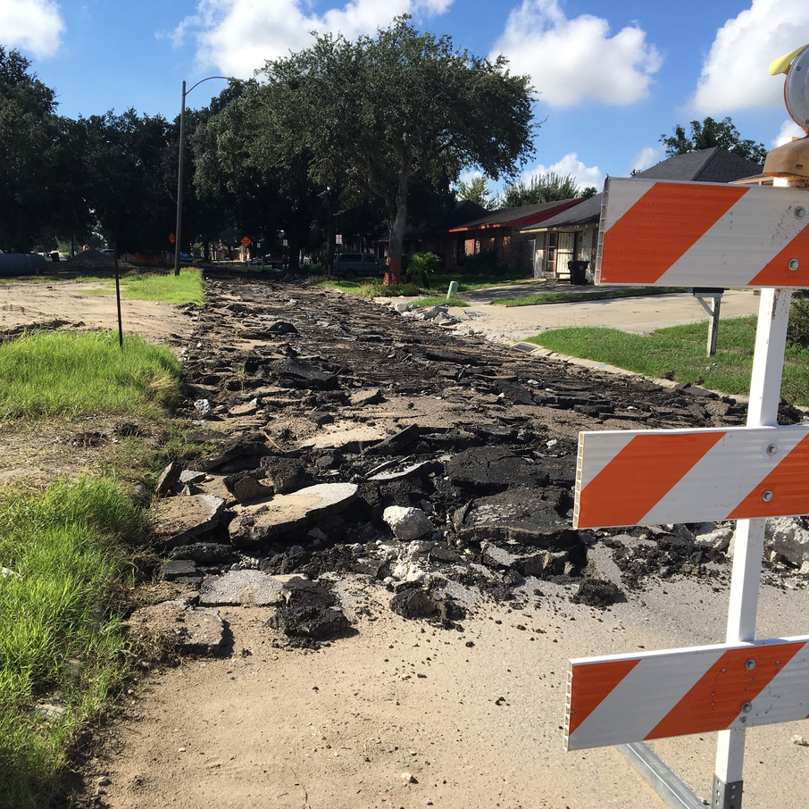
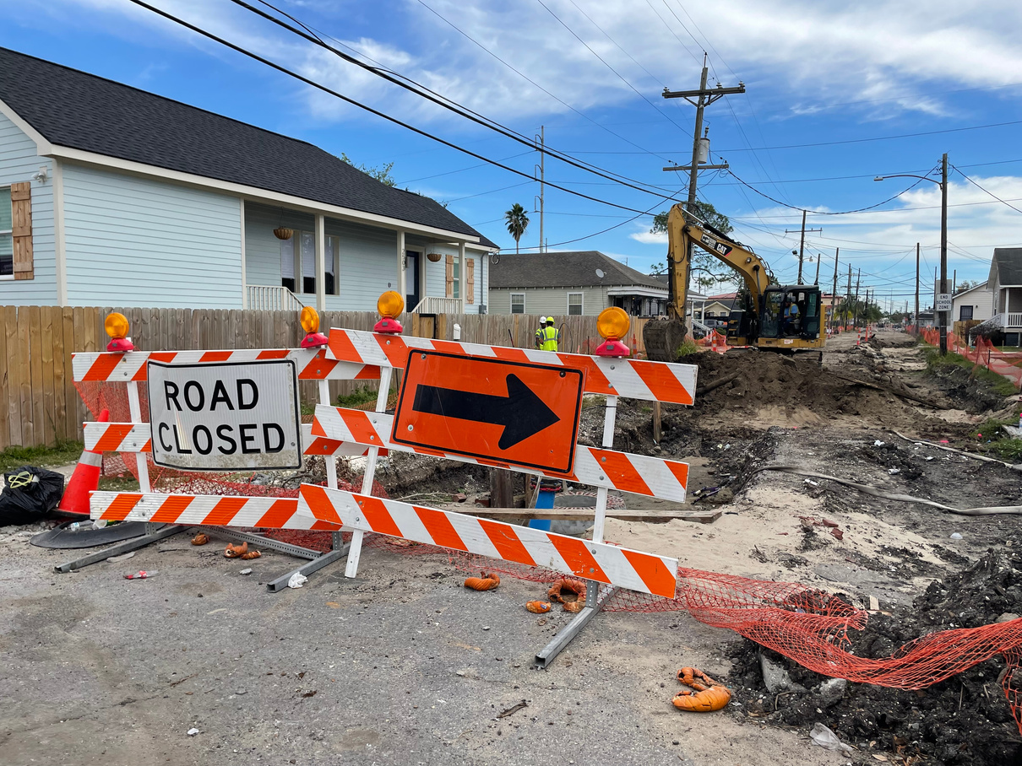
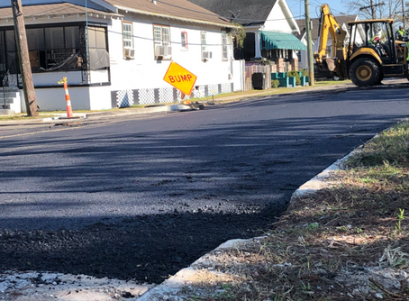
What to Expect Onsite
during construction
Temporary Construction Impacts:
Noise, dust, debris​
Equipment and materials staged in your area​
The possibility of more flooding than usual during rain events
Contractor and subcontractor on site meetings with staff​
Everything will be secured on site ahead of any major storm event
We’re here to help! Let us know if…​
• Any changes to garbage and US Postal services will be communicated in advance ​
• Debris or materials blocking driveway​
• If you aren’t getting notices or alerts, make sure to Text ROADWORK to 77295 or go to ready.nola.gov/alerts for updates

Slide 12




Types of Notifications
you may receive
Notice of Construction
Notice of Water Service Disruption
Road Closure Notification
Construction is going to start in your area, how you will be impacted including parking, mail delivery, trash pick up​
Water is being shutoff for water line tie-ns and tests​
One or more travel lanes are going to be temporality closed​ to vehicular / pedestrian traffic
  30 days before construction starts​​
  Every 30 days during the project​
  24 to 48-hours prior to service impacts
If you didn’t get a notice, contact your Roadworknola team
  Flyer, door hanger, signage​
  Text, Email
  Flyer, door hanger, signage​
  Text, Email

Slide 13
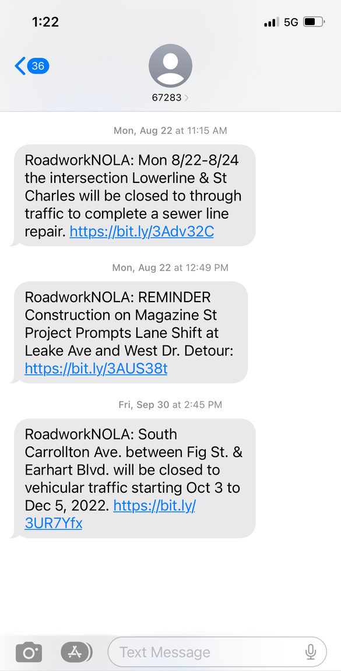
!!
Text Alerts
Sign up to be notified when work will require major road closures, emergency water shutoffs, or other significant impacts via text or email.
To sign up for RoadworkNOLA text alerts, text ROADWORK to 77295 or go to ready.nola.gov/alerts to create a whole profile and select the “roadwork” alert list.

Slide 14
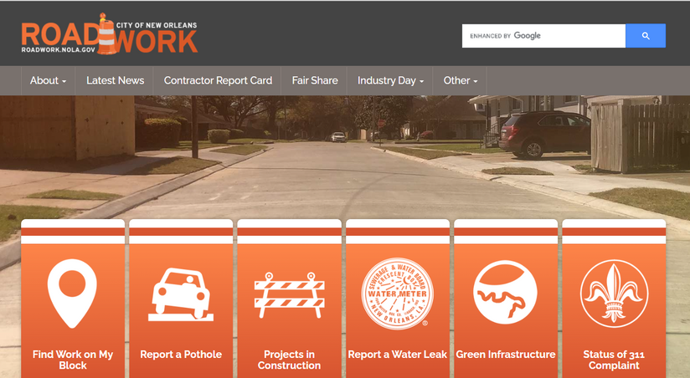

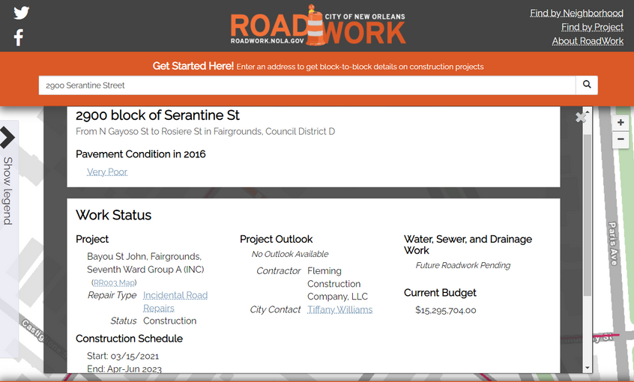
Stay Informed
about work on your block
Visit https://roadwork.nola.gov/home to find work on your block.
Click "Find Work on My Block".
Type in your address on the search bar and click the search icon.
  A drop-down box will list any City or FEMA-funded roadwork that is planned, in construction or completed on your block.

Slide 15









Lauren Muse
Contact Us
The Community Outreach Specialist assigned to this project is Lauren Muse. Lauren will be your point of contact for questions and concerns throughout the duration of construction.
504.658.ROAD (7623)
roadwork@nola.gov
roadwork.nola.gov
facebook.com/roadworknola
@roadworkNOLA
@roadworkNOLA
NextDoor

Slide 16


Questions
This meeting is to keep you informed with key details about the construction operations that will be happening in your area. Here are examples of on-topic and off-topic questions:
On
Off
How will I be impacted?
Topic
Topic
Can I suggest a route changed route?
When will 1234 Main Street be repaired?
What's the timeline for this project?
How do I get more information on projects in my area?
Can the contractor cut down my tree?

